Slide 1
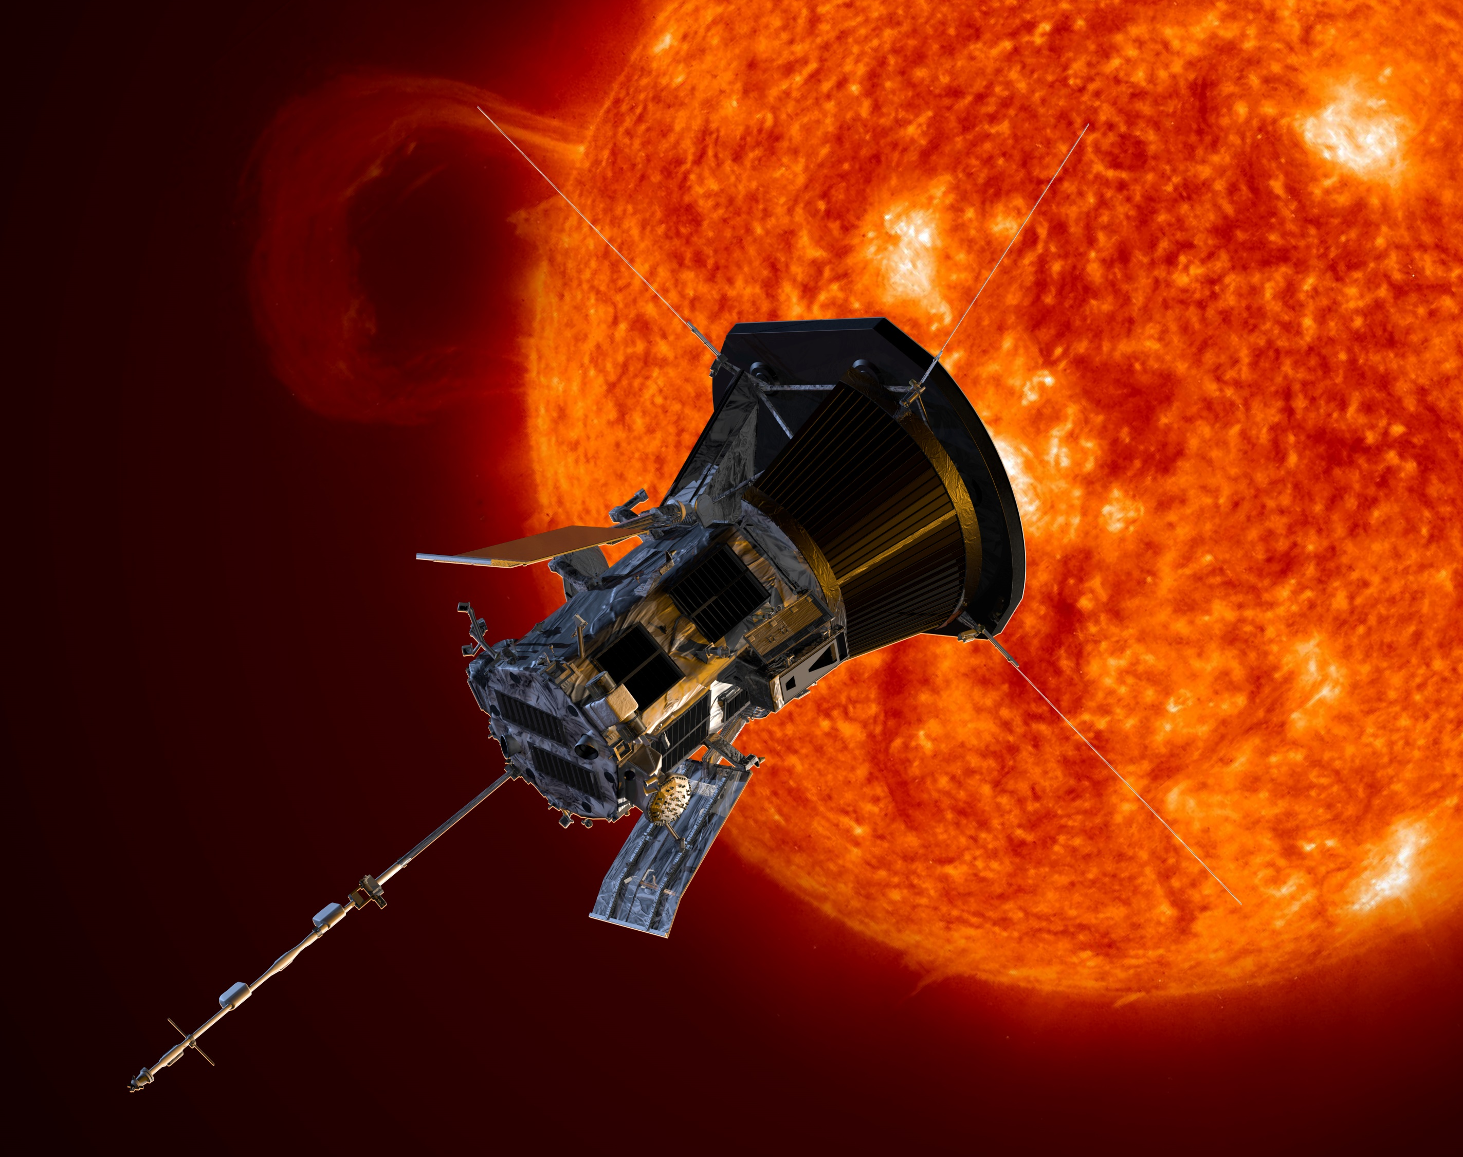

Challenge name: Unlocking the secrets of the sun
TEAM: HACKATOMICS

Slide 2

Problem: Access to information about closest star (the sun) to raise awareness and generate public understanding.
Technologies: Azure WordPress, Model Viewer, Sketchfab, Microsoft 365.
Areas: Technologies of the information, computing and management.
Contact: Jorge Ivan Cuellar Razo- crew317@innovaccion.mx

Slide 3
Explanition of our project
Our project consists in realize a webpage, was carried in which users who access it will be able to interact with the Probe which was created in order to be able to have an approach to everything that is provided of information about our solar system and its secrets.
It is of the utmost importance that the method of using our page is simple and straightforward since being for open public, anyone who has that tickle of knowing what a satellite in orbit is like, has no problems with using it and on this it is easy to interact.

Slide 4
In addition to this, we plan that the information that NASA updates every day, be used on our website in order to have greater credibility regarding the data used for the development of this 3D satellite prototype in virtual reality.
EXPLANITION AND STEPS TO FOLLOW:
FLOWCHART: We did a flowchart, it was made to see the eteps to follow for each element that needs to be done for our Project in this flowchart we can see the steppsmto follow in the 3D model, the decisions that are made when creating a web page, the steps that were made on the website and reaching the last step when the website is already up and running.
3D MODEL: We obtained a Parker Solar Probe Object, we test and built the 3D model modifiyng the parameters like a color, shadows or anyone parameter. After that it was posible to make a model of the Parker Solar Probe with colors that Help to simulate that it is in space

Slide 5
WEBSITE: the first thing that was done was to take the resources of Microsoft Azure to be able to open WordPress later, as in the image that is on the side to start performing the steps to follow to start creating a web page.
References:
https://2021.spaceappschallenge.org/challenges/statements/unlocking-the-secrets-of-the-sun/resources
https: //svs.gsfc.nasa. gov / search /? chunk = 1 & release_date_gte = & release_date_lte = & search = parker% 20solar% 20probe & sort_by = relevance
https://svs.gsfc.nasa.gov/12946
https://svs.gsfc.nasa.gov/13484
https: // svs.gsfc.nasa.gov/13484
https://www.nasa.gov/content/goddard/parker-solar-probe-instruments

